Slide 1

The problem of overfitting
Regularization
Machine Learning

Slide 2
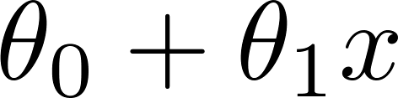
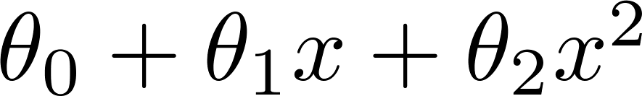
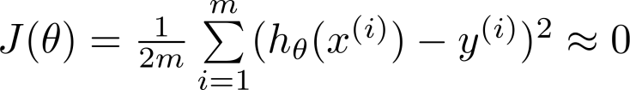
Example: Linear regression (housing prices)
Price
Price
Price
Size
Size
Size
Overfitting: If we have too many features, the learned hypothesis may fit the training set very well ( ), but fail to generalize to new examples (predict prices on new examples).

Slide 3
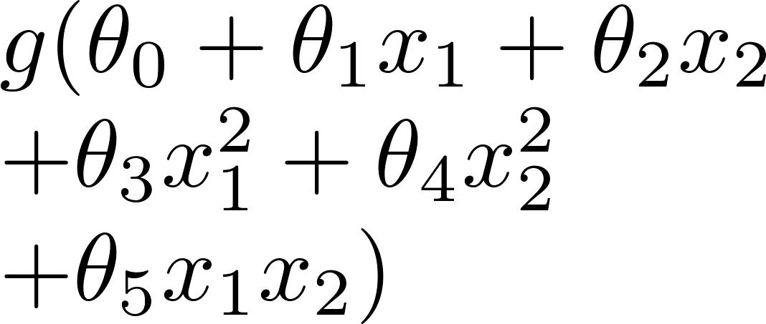
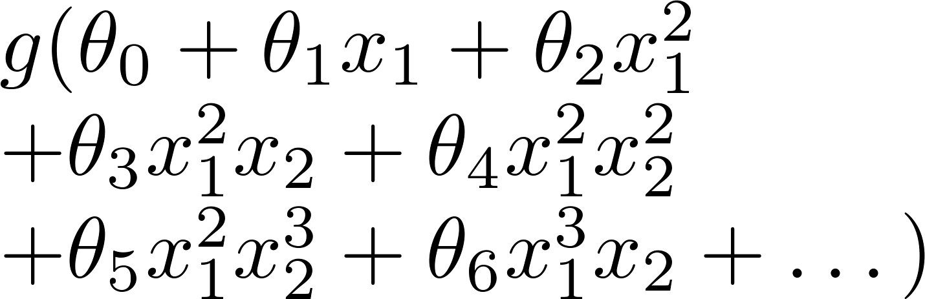
Example: Logistic regression
x₂
x₂
x₂
x₁
x₁
x₁
( = sigmoid function)

Slide 4






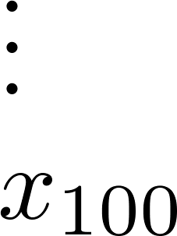
Addressing overfitting:
size of house
no. of bedrooms
Price
no. of floors
age of house
average income in neighborhood
Size
kitchen size

Slide 5


Addressing overfitting:
Options:
Reduce number of features.
Manually select which features to keep.
Model selection algorithm (later in course).
Regularization.
Keep all the features, but reduce magnitude/values of parameters .
Works well when we have a lot of features, each of which contributes a bit to predicting .

Slide 7
Cost function
Regularization
Machine Learning

Slide 8


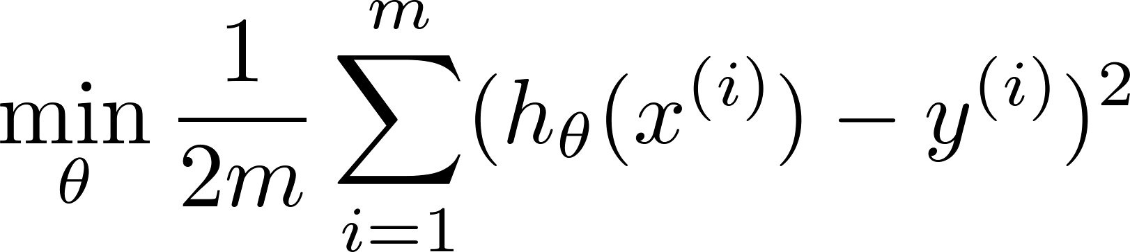
Intuition
Price
Price
Size of house
Size of house
Suppose we penalize and make , really small.

Slide 9
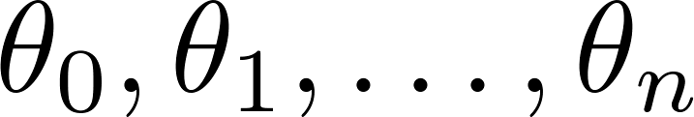
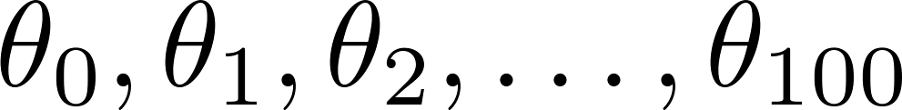
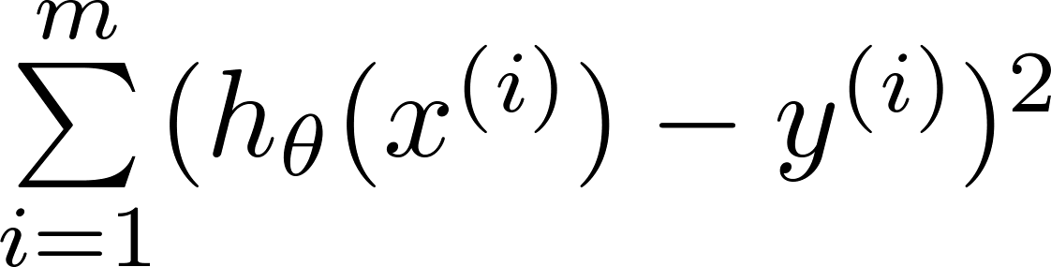
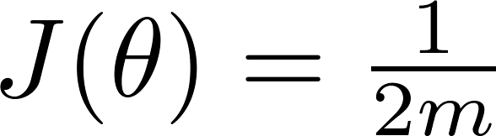
Regularization.
Small values for parameters
“Simpler” hypothesis
Less prone to overfitting
Housing:
Features:
Parameters:

Slide 10
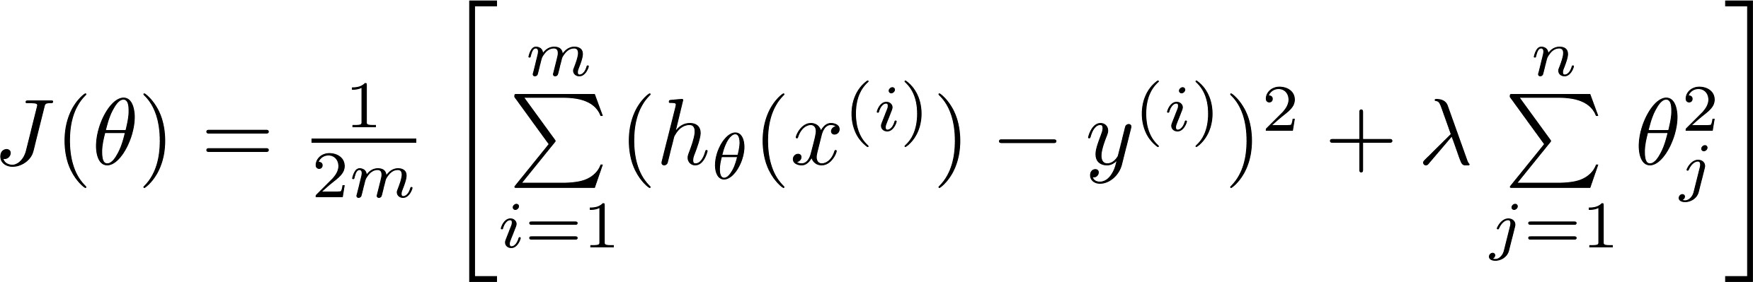
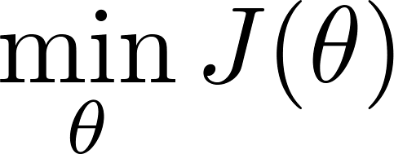
Regularization.
Price
Size of house

Slide 11


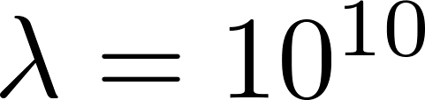
In regularized linear regression, we choose to minimize
What if is set to an extremely large value (perhaps for too large for our problem, say )?
Algorithm works fine; setting to be very large can’t hurt it
Algorithm fails to eliminate overfitting.
Algorithm results in underfitting. (Fails to fit even training data well).
Gradient descent will fail to converge.

Slide 12
In regularized linear regression, we choose to minimize
What if is set to an extremely large value (perhaps for too large for our problem, say )?
Price
Size of house

Slide 14
Regularized linear regression
Regularization
Machine Learning

Slide 15
Regularized linear regression

Slide 16

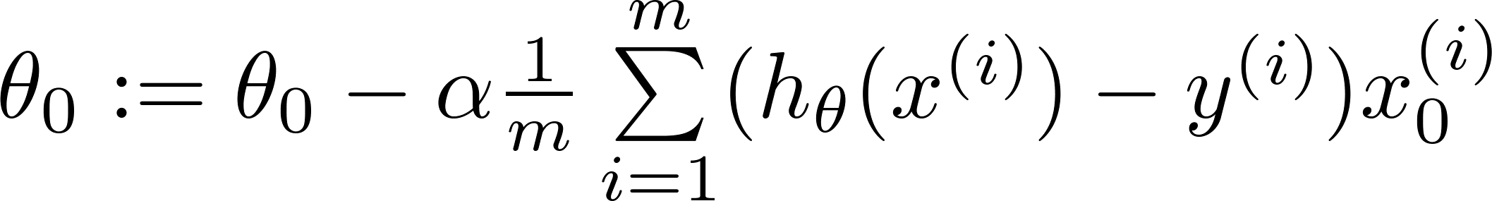
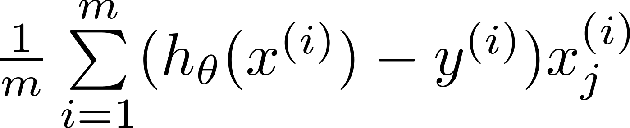
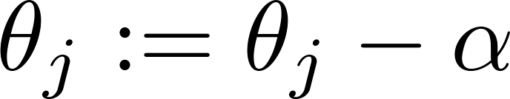


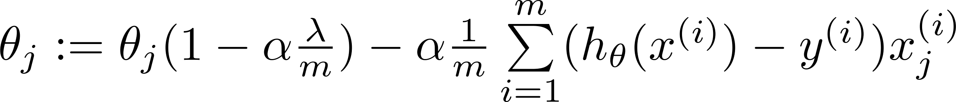
Gradient descent
Repeat

Slide 17
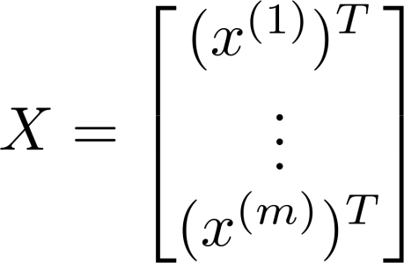
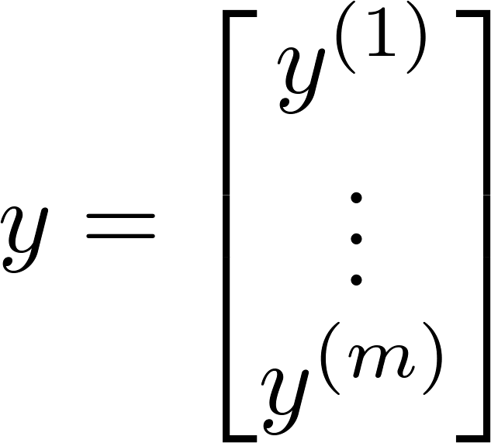
Normal equation

Slide 18
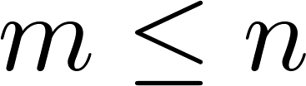
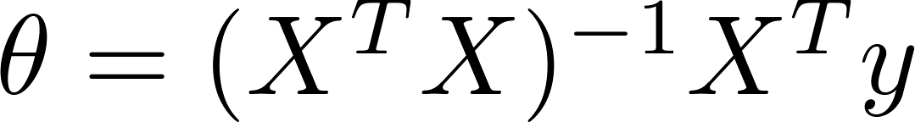

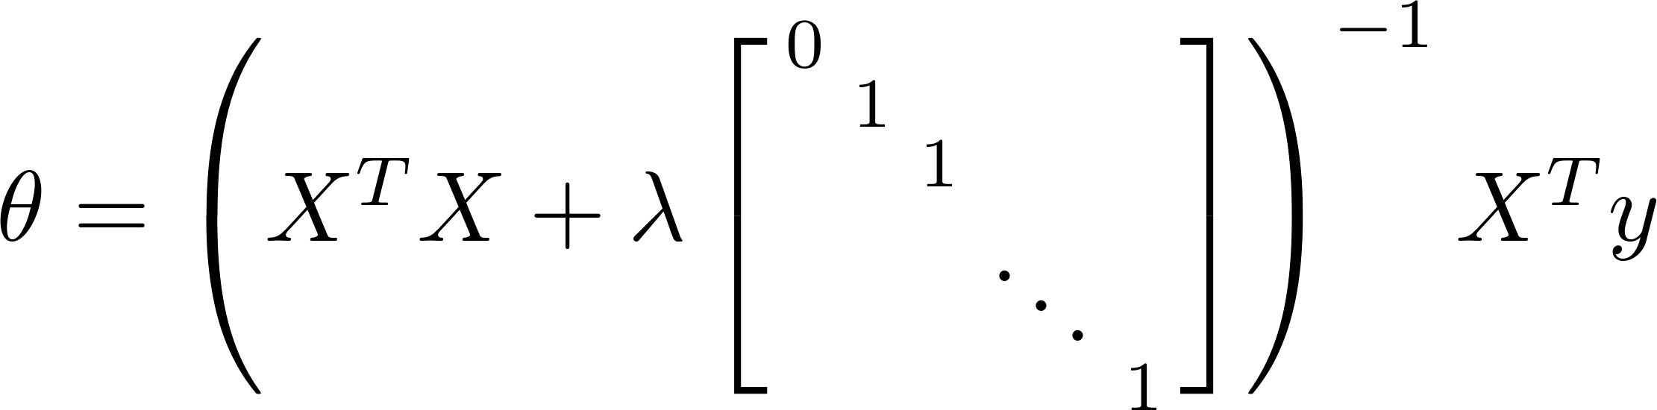
Non-invertibility (optional/advanced).
Suppose ,
(#examples) (#features)
If ,

Slide 20
Regularized logistic regression
Regularization
Machine Learning

Slide 21
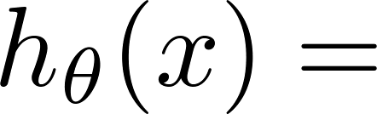
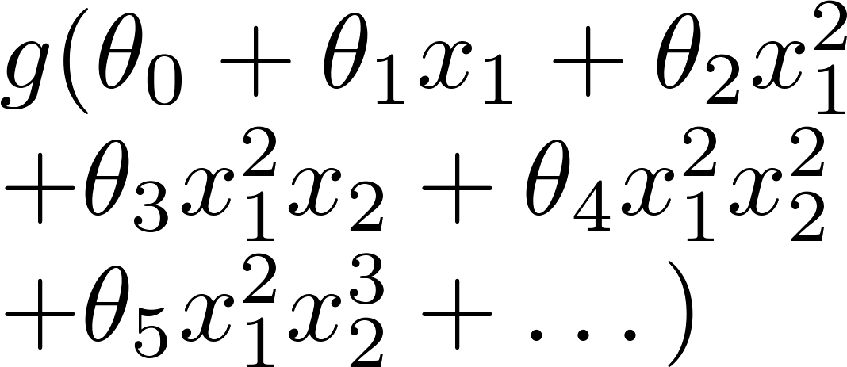
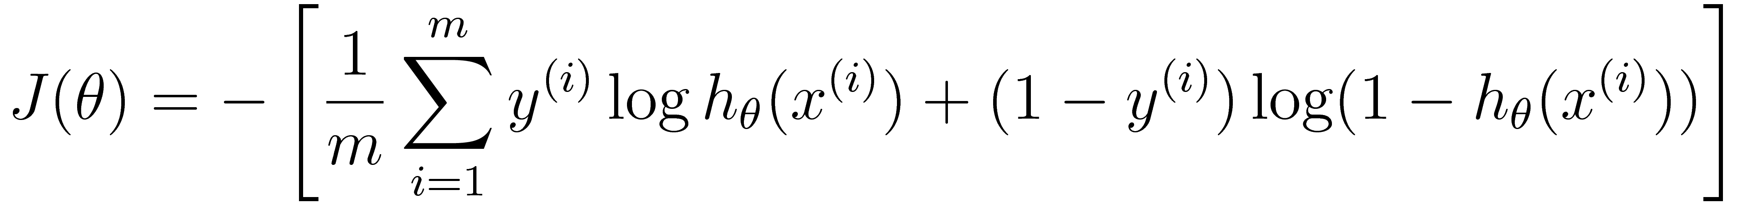
Regularized logistic regression.
x₂
x₁
Cost function:

Slide 22
Gradient descent
Repeat

Slide 23


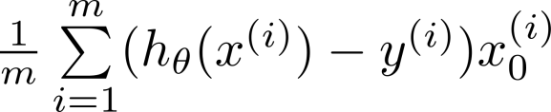

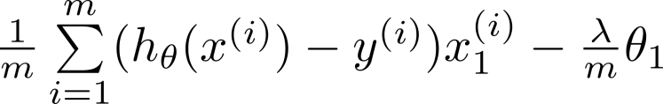

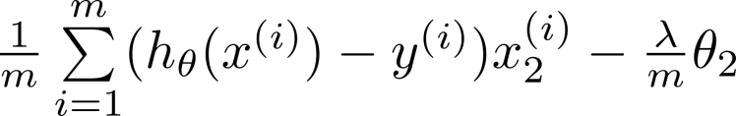

Advanced optimization
function [jVal, gradient] = costFunction(theta)
code to compute
jVal = [ ];
code to compute
gradient(1) = [ ];
code to compute
gradient(2) = [ ];
code to compute
gradient(3) = [ ];
code to compute
gradient(n+1) = [ ];

